Slide 1
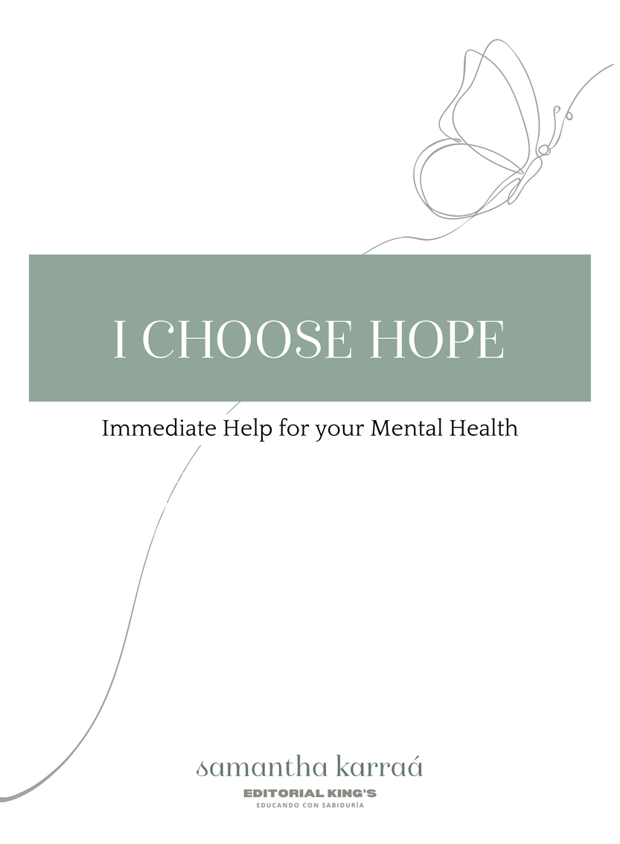
I Choose Hope
A 14 Week Long Journey through the 7 Recovery Principles of Fresh Hope

Slide 2

Confidentiality
What is said here stays here
We don´t give Advice
We listen without judging. We share from our experience.
Community Guidelines
Key Elements for a Safe and Hope Filled Space
We are Peer Support
We do not replace medical or professional help.
Language of Hope
We don´t just vent. We seek to move forward.

Slide 3
Check-In
Mood
1
2
3
4
5
Depressive
Sad
Neutral
Good
Stable
Hope Tank
0%
25%
50%
75%
100%

Slide 4
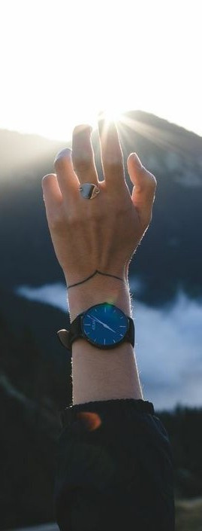
My life is affected by a mental health issue and it can become
unmanageable and hopeless
especially if I ignored or
untreated. Therefore, I choose the help and support of others
to overcome struggles and find more joy in life.
My loved one's mental health challenge has also left me
feeling helpless and hopeless. Therefore, I choose the help
of others to learn about the disorder and choose healthy
boundaries for myself.
Together, we have understanding. We remind each other of
the love of the Lord, and that He alone can do all things. He
is the Source of our hope and in Him we can overcome all
things.
"I can do all things through Christ who strengthens
me." Philippians 4:13 (NIV)
PRINCIPLE
1
ACCEPTING
Blue Paragraph: Person with diagnosis Green Paragraph: Loved One Black Paragraph: Working it together Red paragraph: The verse that accompanies the
beginning of the paragraph

Slide 5
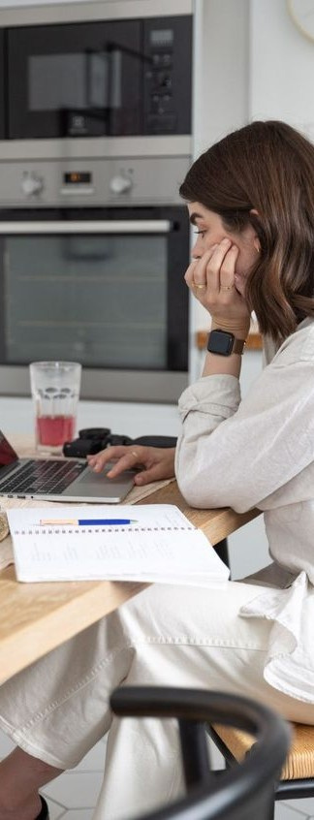
My mental health challenge has also affected my relationships and the lives of those around me. Therefore, I choose to overcome both for my own sake, and for the sake of those who love me.
I have not always responded to my loved one's mental
health situation in ways that were good for the relationship.
Therefore, I choose to learn better ways to communicate
with, support and encourage my loved one.
Together, we commit ourselves to speaking the truth in love,
healing broken relationships and looking at each other as the
Lord looks at us.
"Therefore, let us follow that which contributes to peace and
mutual edification."
Romans 14:19 (NKJV1995)
PRINCIPLE
2
THE DOMINO EFFECT
Blue Paragraph: Person with diagnosis Green Paragraph: Loved One Black Paragraph: Working it together Red paragraph: The verse that accompanies the
beginning of the paragraph

Slide 6

My disorder can become an excuse. Therefore, I choose to believe that I can live a full and abundant life in spite of my disorder. I choose the support of people who will push me to "push through".
There are times when I don't understand my loved one and I
may either let them wallow in their excuses, or I push them
and
PRINCIPLE
3
PUSHING THROUGH
too
hard.
Therefore,
I
choose
to
learn
healthy
appropriate ways to contribute to my loved one's recovery.
Together we do better than trying to go it alone. Let's hold
each other accountable to learn, grow and choose to push
forward in hope.
"Therefore, be encouraged and build each other up, just as
you have been doing."
1 Thessalonians 5:11 (NIV)
Blue Paragraph: Person with diagnosis Green Paragraph: Loved One Black Paragraph: Working it together Red paragraph: The verse that accompanies the
beginning of the paragraph

Slide 7
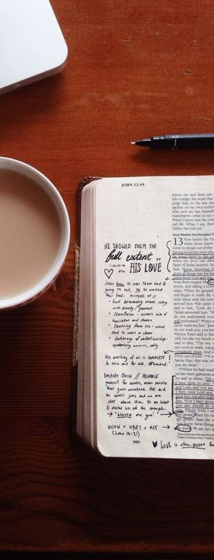
My disorder can lead me to feel hopeless. Therefore, I choose to believe, no matter how I feel, that there is help and hope for my physical, emotional, psychological and spiritual well-being.
There are times when I too feel hopeless, allowing my loved
one's actions and recovery to define my happiness.
Therefore, I choose to live with healthy emotional
boundaries, and I choose my own joy despite my loved one's
ups and downs.
Together we remind each other that our hope and joy come
from the Lord. He alone can fulfill our needs in every aspect
of our lives.
"Because I know very well the plans I have for you.
-The Lord affirms, "plans of welfare and not of calamity, in
order to give them a future and a hope".
PRINCIPLE
4
THERE IS HOPE
Blue Paragraph: Person with diagnosis Green Paragraph: Loved One Black Paragraph: Working it together Red paragraph: The verse that accompanies the
beginning of the paragraph
Jeremiah 29:11 (NIV)

Slide 8

Although medicine is a key component in my recovery, it is not the only answer. Therefore, I choose to explore new ways of thinking and acting in my relationships and daily life.
I too have been part of the dysfunctional cycle of living,
either thinking that I had all the answers or thinking that the
problem did not belong to me. Therefore, I choose to submit
myself to learning new behaviors and taking responsibility for
my own healthy and balanced living.
Together we choose freedom over suffering, and joy in living
through self-knowledge in action.
"Casting down arguments and every high thing that exalts
itself against the knowledge of God, and bringing into
captivity every thought to the obedience of Christ."
2 Corinthians 10:5
PRINCIPLE
5
IS A CHOICE: ELÍGELA!
Blue Paragraph: Person with diagnosis Green Paragraph: Loved One Black Paragraph: Working it together Red paragraph: The verse that accompanies the
beginning of the paragraph

Slide 9
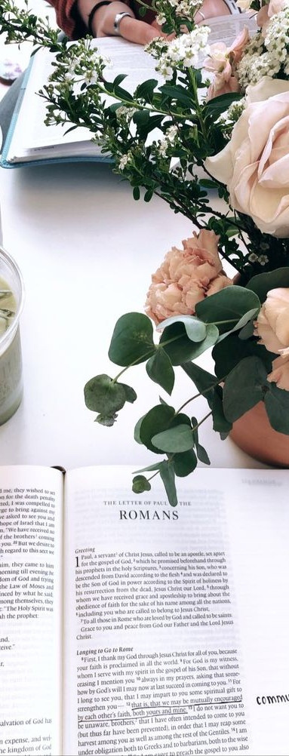
At times I have allowed myself to become a victim "defined" by my disorder. Therefore, I choose to overcome and live in hope and joy, despite my disorder.
At times, I have seen myself as a victim of my loved one's
behavior and disorder, causing resentment, anger, and lack
of forgiveness or self-compassion. Therefore, I choose to
separate the disorder from the person I love, forgive, and let
go of the past, and live as a contributor to a successful
recovery.
Together, we share in each other's victories and celebrate
the whole person.
"For God has not given us a spirit of fear, but of power and
of love and of a sound mind."
PRINCIPLE
6
LIVING A LIFE OF ABUNDANCE: IN SPITE OF THIS
2 Timothy 1:7
Blue Paragraph: Person with diagnosis Green Paragraph: Loved One Black Paragraph: Working it together Red paragraph: The verse that accompanies the beginning of the paragraph

Slide 10

At times, my mental health challenge has caused me to focus only on myself and my needs, leading me to believe the lie that I don't have much to offer others. Therefore, because focusing on others will help me grow, I choose to give back by sharing my story with others, so that my past pain can provide insights for someone else's journey to live well.
I too have focused on my loved one's situation and how it has affected
me. I can easily become so consumed by our problems that I fail to see
those around me who would benefit from what I have learned.
Therefore, I choose to give back by looking for opportunities to help
others by sharing my knowledge and experiences.
Together we recognize that sharing helps us and others to heal. Sharing
helps us find our voice and becomes empowering as we see our pain
redeemed by the Lord. In sharing, it helps us reaffirm our own hope
while giving hope to others.
"He comforts us in all our difficulties so that we can comfort others.
When others go through difficulties, we will be able to offer them the
same comfort that God has given us."
2 Corinthians 1:4 (NTV)
PRINCIPLE
7
RELEASING WELLNESS
Blue Paragraph: Person with diagnosis Green Paragraph: Loved One Black Paragraph: Working it together Red paragraph: The verse that accompanies the
beginning of the paragraph

Slide 11
The Hope Prayer
“God, grant me the Hope that comes only from You.
Purpose that gets stronger in adversity and
Faith that, in You, I can live a full and rich life in spite of any circumstance.
I receive from You the Patience,
the Joy that Nobody can take away from me
and thecalmed and well balanced mind of Christ.
In Jesus´ Name
Amen.”

